Slide 1










Digital Analysis of Ionospheric Plasma On-board Waves, Instabilities & Noise Spectrometer (WINS)
Ahmad Qureshi
Advised By:
Naomi Yescas

Slide 2
Waves, Instabilities & Noise Spectrometer (WINS)
WINS is a specialized instrument to be deployed on a CubeSat,
It can delve into the intricacies of the ionosphere by collecting and analyzing electrostatic waves.
Focused on measuring ionospheric plasma at magnetohydrodynamic scales.

Slide 3
What I Did As Part Of WINS

Slide 4
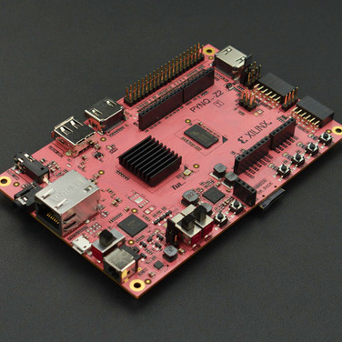
ABOUT MY PROJECT
I created a new Fast Fourier Transform (FFT) and programmed it onto an FPGA board
I took the concept from an idea, to an algorithm, to novel digital hardware
I did a lot of learning along the way!

Slide 5

Approach
Understand FFTs
Create Algorithm
Create Hardware
I spent time understanding the FFT and its application in research
I created an algorithm that did a FFT in C
I spent a lot of time converting the C to a Verilog/Hardware Implementation

Slide 6
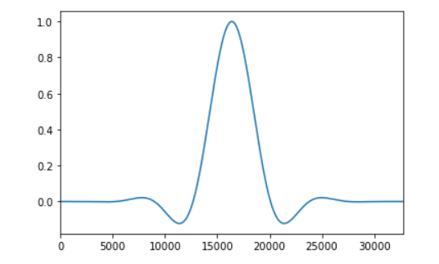
Fourier Analysis:
Windowing
Windowing is taking the data and multiplying it by some value to avoid any one data point from affecting any other data point

Slide 7
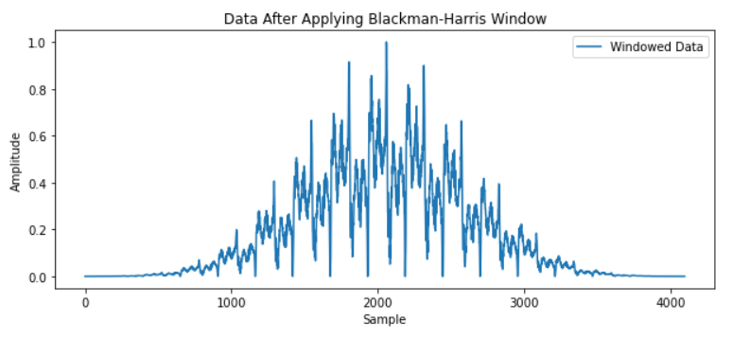
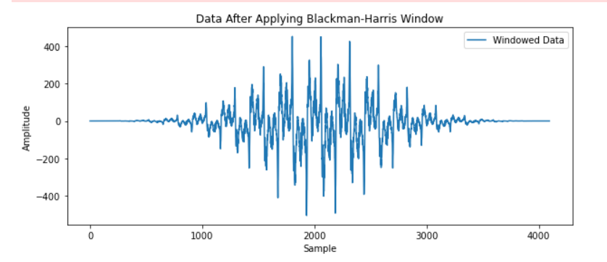
Fourier Analysis: Post-Windowing
In creating an unsigned integer transform, all data had to be converted to positive.
This moved negative numbers to be low and positive numbers to be high.
This is the same data!

Slide 8
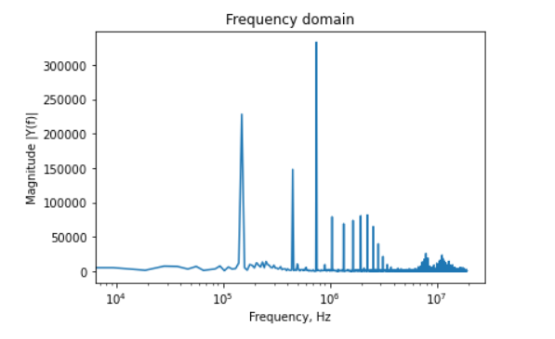
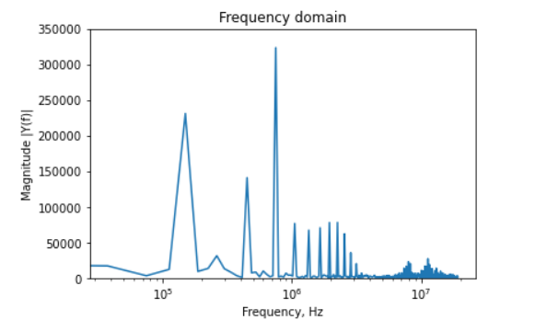
Output Data - CPU
Signed Data
Unsigned Data

Slide 9
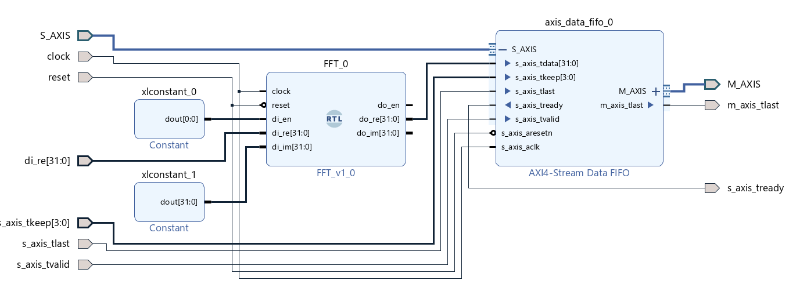
Hardware Implementation:
Block Diagram

Slide 10
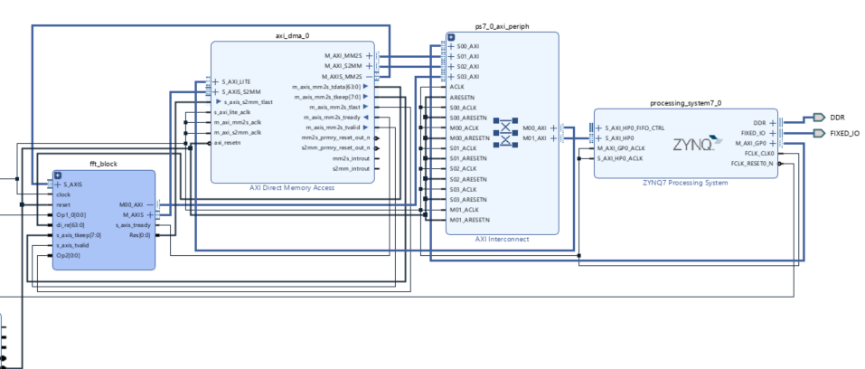
Hardware Implementation:
Block Diagram

Slide 11
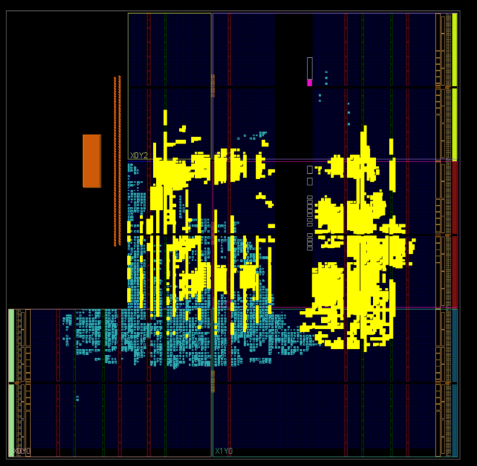
PYNQ Board Implementation
Yellow pins are wired to create my prototype Fourier Transform Circuit!

Slide 12
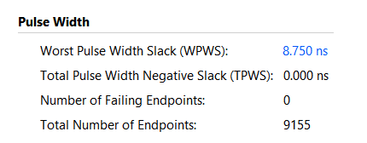
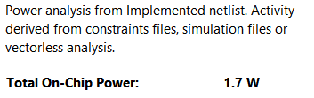
Final FFT Statistics
Max Latency:
8.75 ns
114 MHz
Power Utilization:
1.7 Watts

Slide 13
Next Steps
Run test data through the prototype and test the FFT
Create an ASIC that completes the same thing as the hardware on the FPGA
Place the created ASIC on a larger PCB
Test, test, test!

Slide 14
Acknowledgements
Thank you to these great people!
My PI, Mihailo Martinovic
My mentor, Naomi Yescas
My fellow intern in the lab, Sarina Blanchard

Slide 15
Thank You!

Slide 16
Cyclotron Motion
Since our data has small time, we assume the motion is linear and reject all Cyclotron motion.
We can make this assumption since the relevant waves are damped

